Slide 1
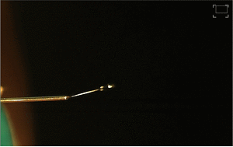
Video S1. Gif animation. Single jet electrospun from cellulose based system
isotropic solution.

Slide 2
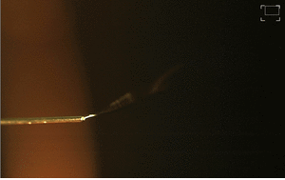
Video S2. Gif animation. Rotating single jet electrospun from cellulose based system liquid crystal solution.

